Slide 1
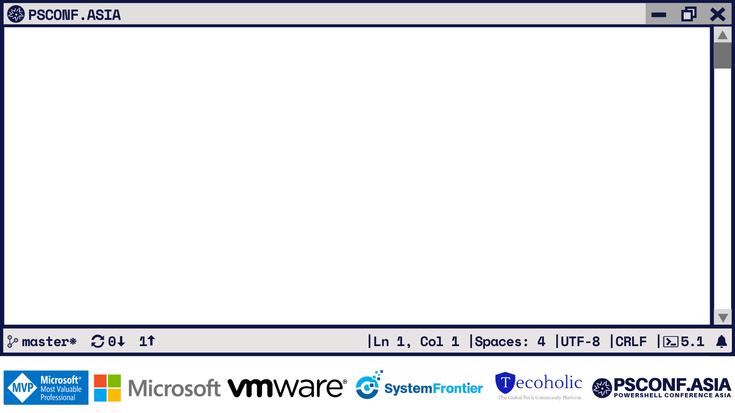
Mastering VSCode
The modern tool for next-gen engineer
Jaap Brasser Developer Advocate, Rubrik

Slide 2



Jaap Brasser
Tweets
Codes
Works
Does
Likes
jaap_brasser
jaapbrasser
Developer Advocate @ Rubrik
Blogger, Speaker, Tech Enthusiast
Cloud Automation & Security

Slide 3


Slide 4
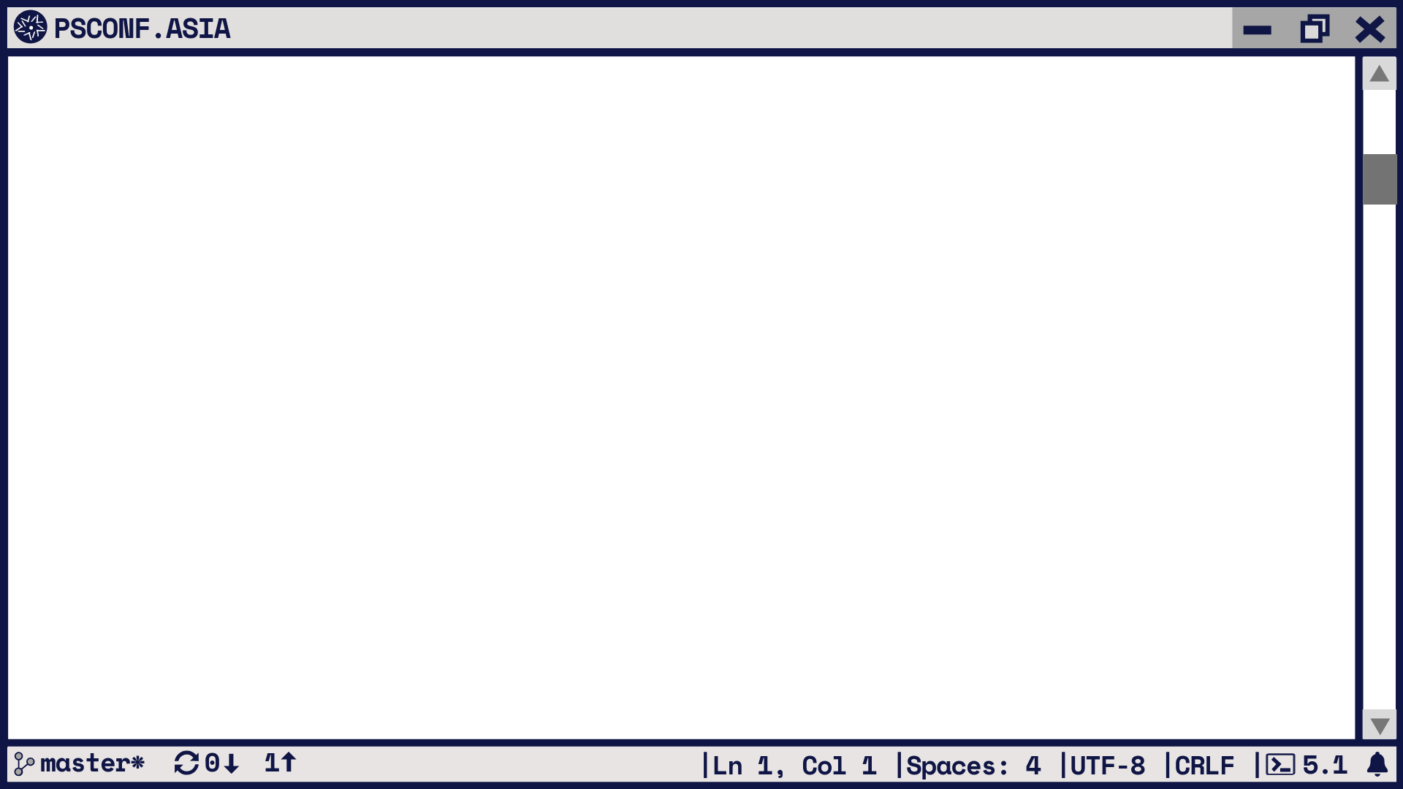
Agenda
Writing Code
PowerShell ISE
Vscode
Demos
Q&A

Slide 5
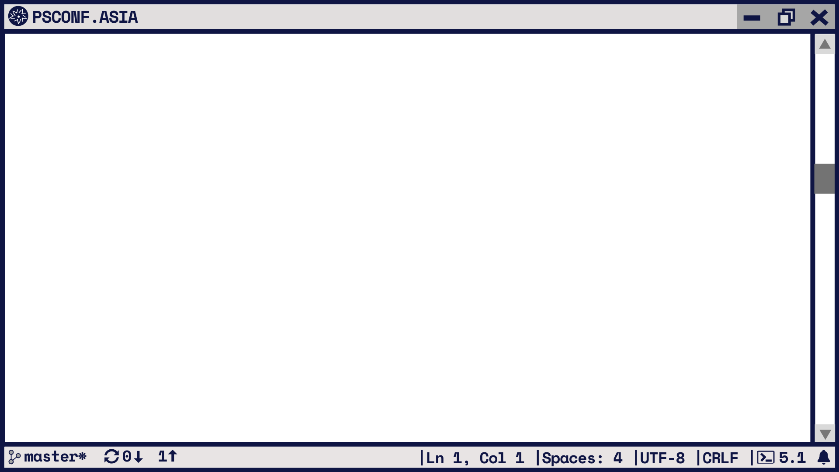


Slide 7
Write Code
Write working code
Collaboration
Validation
Testing

Slide 8
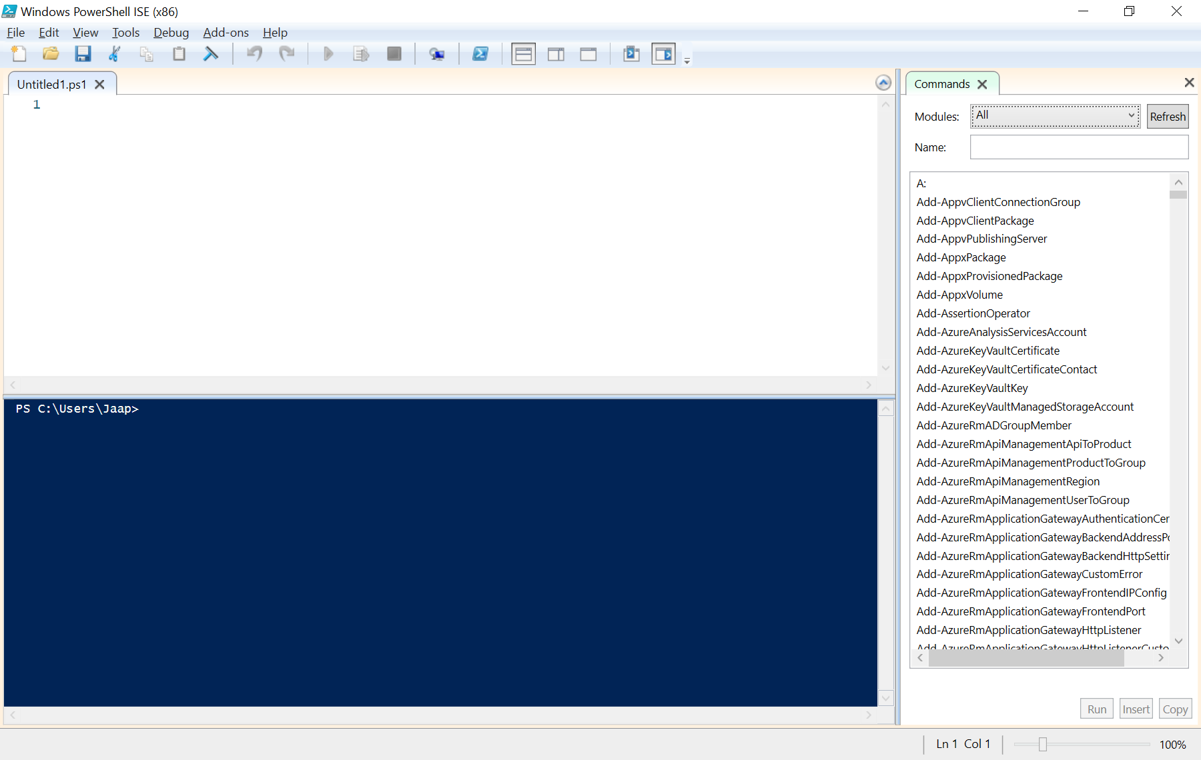

Slide 9
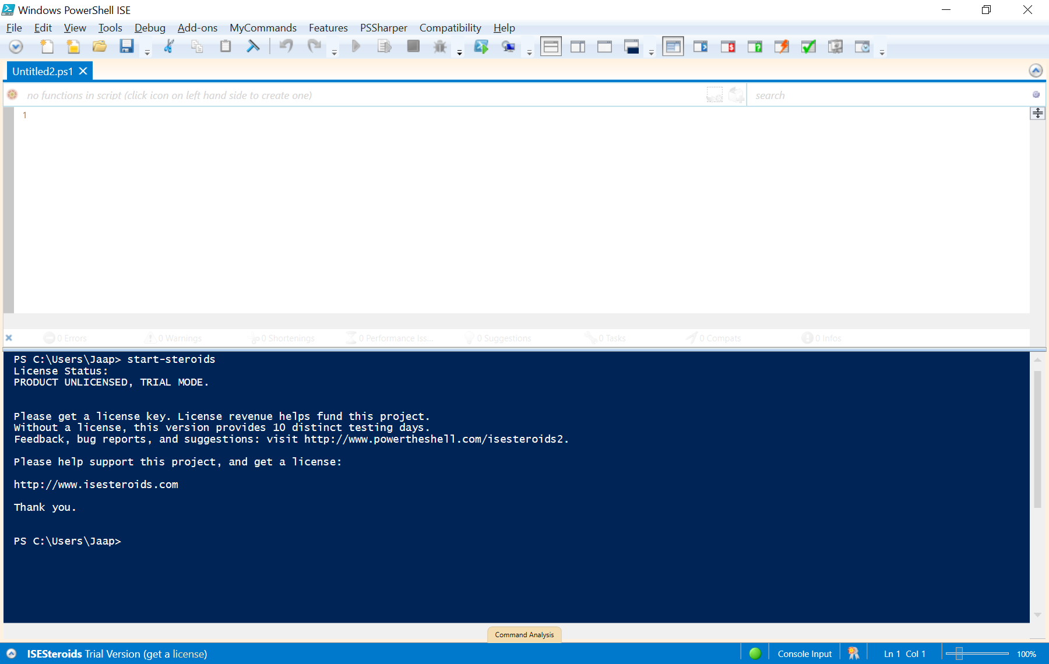

Slide 10
PowerShell ISE
Windows Release Cycle
Closed Source
No longer Developed
Stable

Slide 11
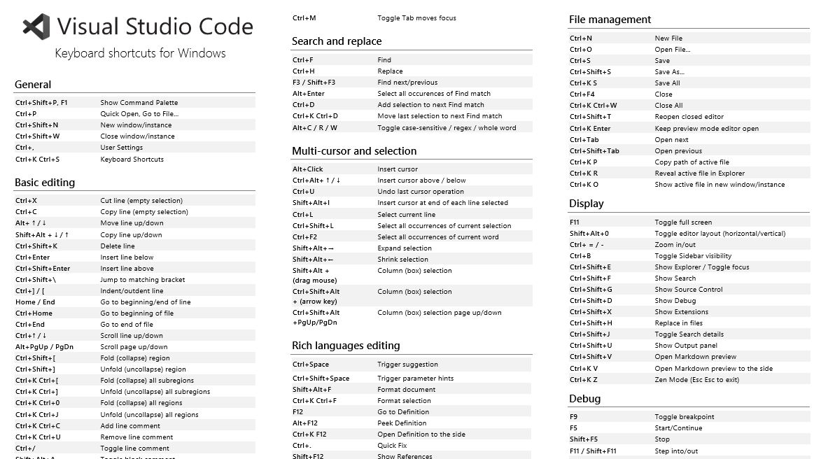

Slide 12
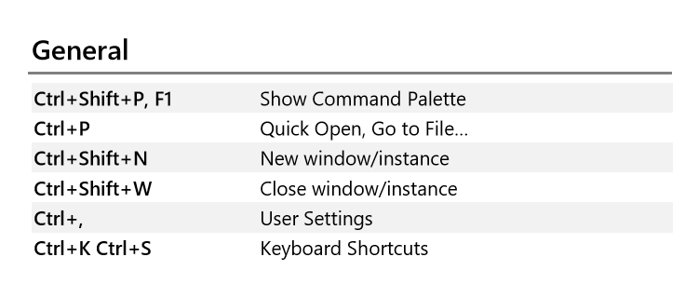

Slide 13
VSCode
Active Development
Frequent releases
Extensible
Cross-platform

Slide 14
Demo
Digging into Vscode and ISE

Slide 15
Demo Summary
Configuring VScode
Default Language
Working with Git
Reviewing a Pull Request
Make it Awesome

Slide 16
